Slide 1
UML
Class Diagrams
IT 426

Slide 2
What are class diagrams?
“… describes the types of objects in [a] system and the various kinds of static relationships that exist among them. Class diagrams […] show the properties and operations of a class ...”
Martin Fowler – UML Distilled

Slide 3
Landscape
Diagram
Structure Diagram
Profile Diagram
Composite Diagram
Component Diagram
Deployment Diagram
Package Diagram
Object Diagram
Class Diagram
Behavior Diagram
Use Case Diagram
Activity Diagram
Interaction Diagram
Sequence Diagram
Communication Diagram
Timing Diagram
State Machine Diagram

Slide 4
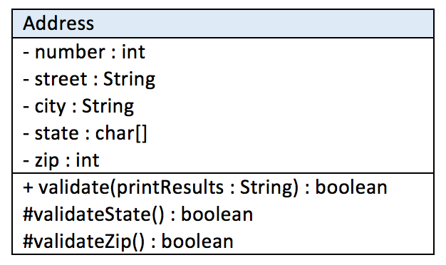
Basic elements
Each diagrams is used to model a class
General form
ClassName
Attributes
Operations

Slide 5
Properties (fields)
Properties of a class diagram represent class fields
Properties can be represented as
Attributes
Associations
General form of an attribute
visibility name: type multiplicity = default {property-string}
Property
Attribute
Association

Slide 6
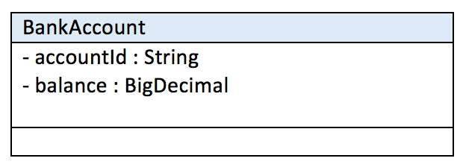
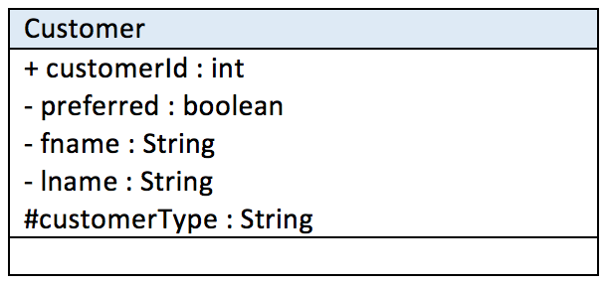
Visibility
The visibility of an attribute represents an access modifier
Modifier | Character
private | -
public | +
protected | #
package | ~

Slide 7
Property Strings
Property strings include extra information about a field
Modifier | Description
id | Property is part of the identifier for the class which owns the property.
readonly | Property is read only (isReadOnly = true).
ordered | Property is ordered (isOrdered = true).
unique | Multi-valued property has no duplicate values (isUnique = true).
nonunique | Multi-valued property may have duplicate values (isUnique = false).
sequence (or seq) | Property is an ordered bag (isUnique = false and isOrdered = true).
union | Property is a derived union of its subsets.
redefines property-name | Property redefines an inherited property named property-name.
subsets property-name | Property is a subset of the property named property-name.
property-constraint | A constraint that applies to the property

Slide 8
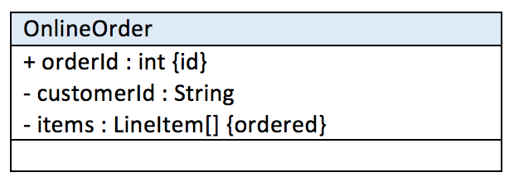
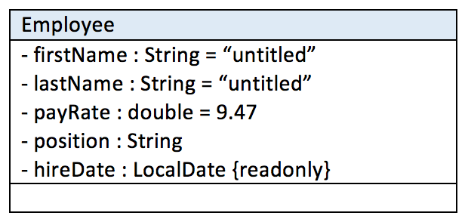

Property Strings

Slide 9
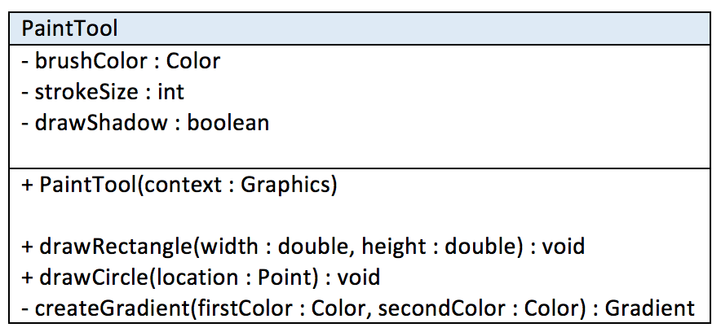
Operations (methods)
Method general form:
visibility name(parameter-list) : return type {property-string}
Parameter general form:
direction name : type = default

Slide 10
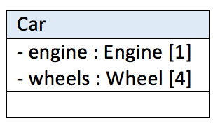
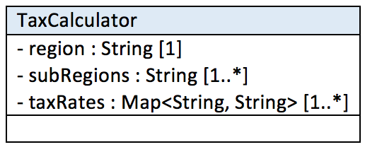
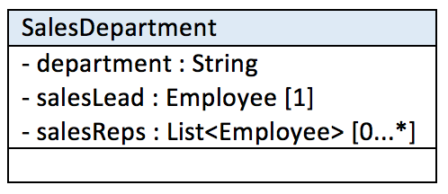
Multiplicity
Indicates how many values are stored in a field
Value | Meaning | Description
1 | Exactly one | single valued (default)
* | Zero or more | multi valued
0..1 | One or none | optional
1..* | One or more | mandatory
2..4 | Two to four | low bound and high bound

Slide 11
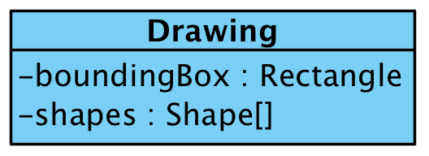
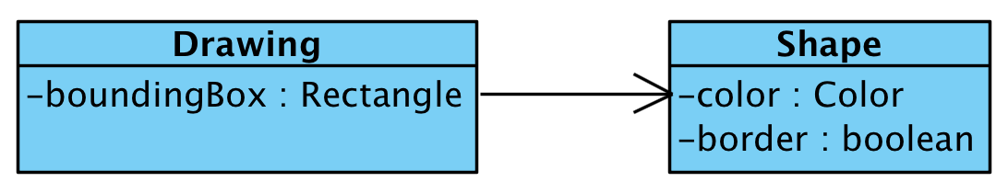
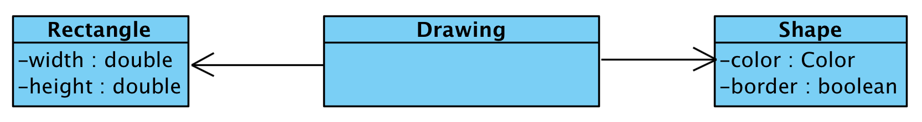
Class Associations
Another way to visualize fields in a class
Represented with a solid line

Slide 12
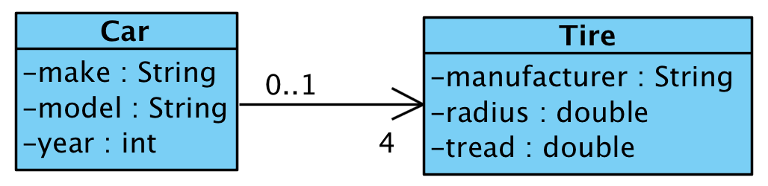
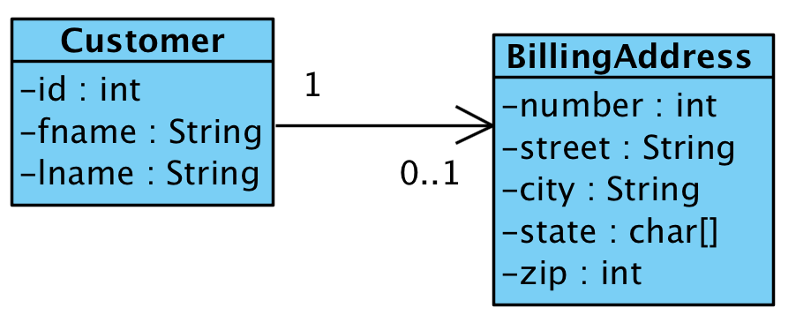
Unidirectional Associations
Represent a one way relationship
Only one class is aware of (stores a reference to) the other
Types
One-to-many
One-to-one
Multiplicity can be declared on both ends of an association

Slide 13
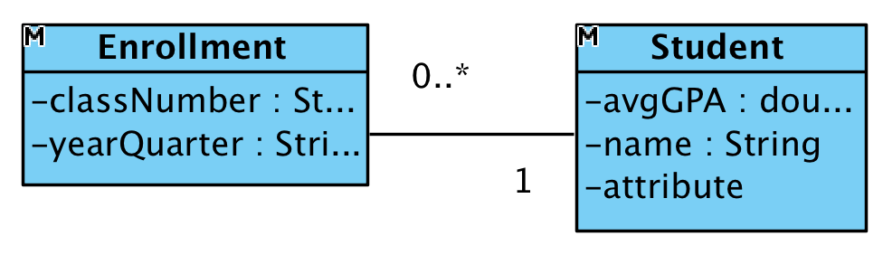
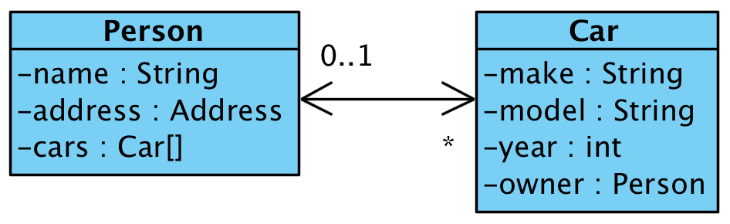
Bidirectional Associations
Represents a two way relationship
Both classes are aware of (store a reference to) each other
Arrows are optional
Multiplicity can be declared on both ends of an association

Slide 14
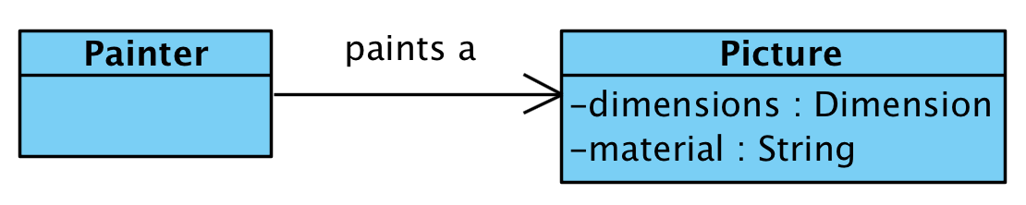
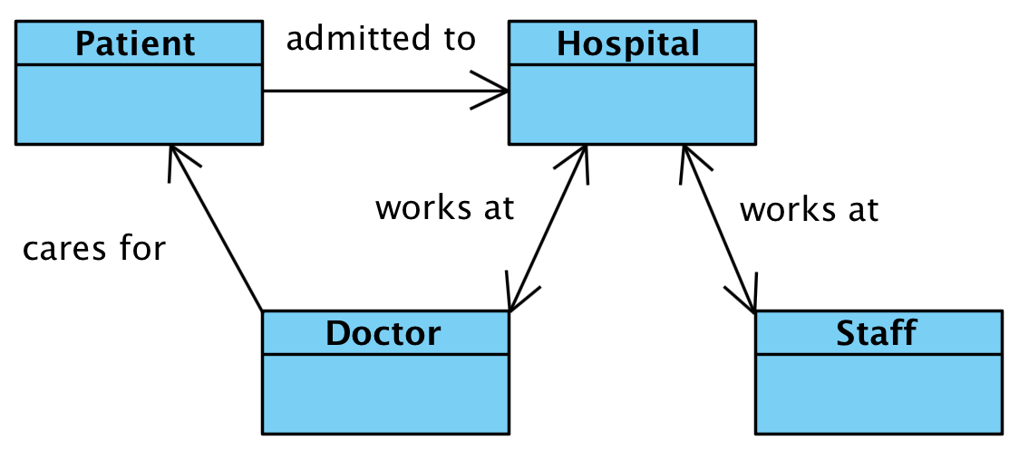
Labeling associations
Giving meaning to our associations

Slide 15
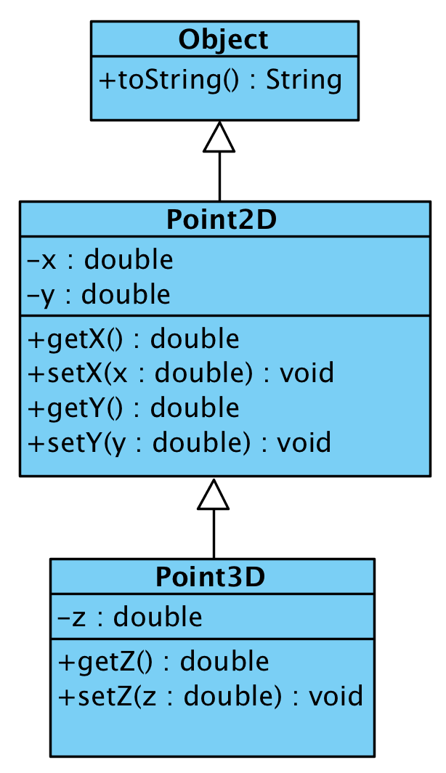
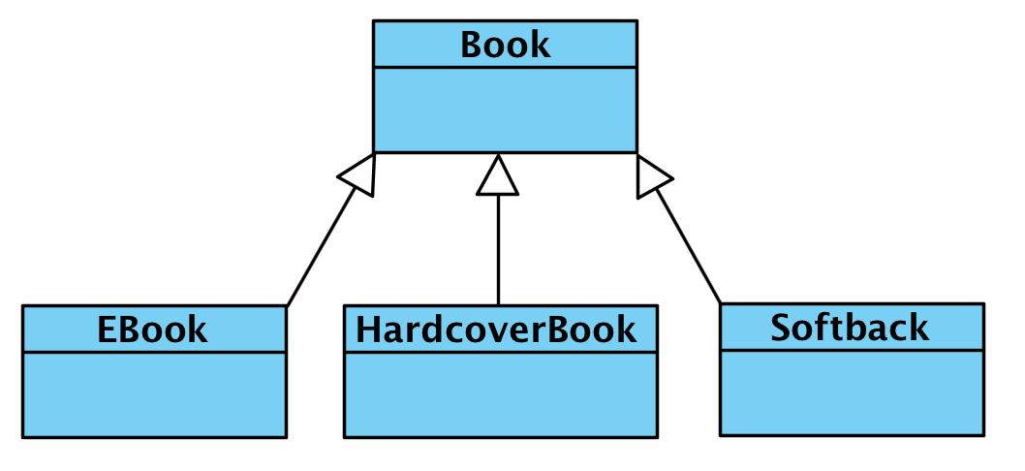
Generalization (Inheritance)
You can express inheritance between classes

Slide 16
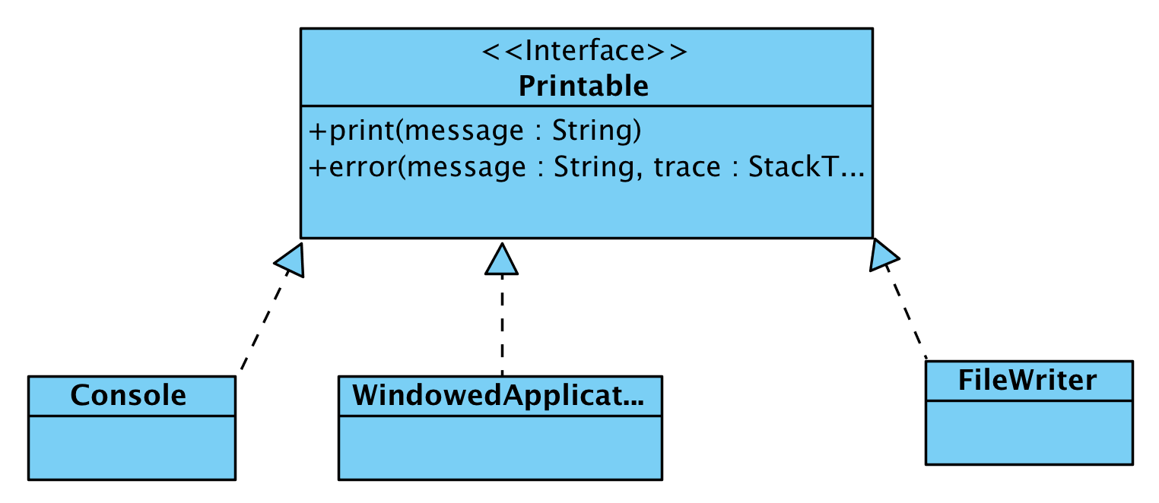
Realization (interfaces)
You can show a class implementing an interface
Interfaces include the <<Interface>> identifier

Slide 17
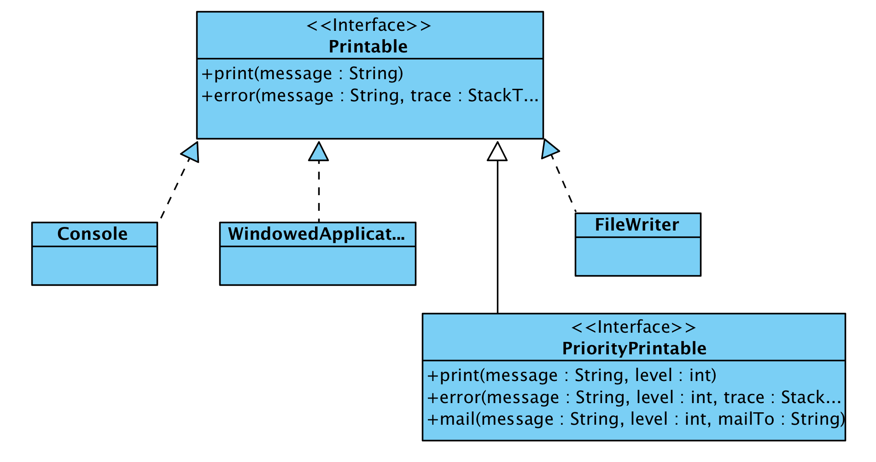
Realization (interfaces)
Another example
Notice the extension of an interface

Slide 18

Dependencies
Exists when a change to the definition of one class may cause changes to the another class
Reasons:
A class is passed to a method in another class
A class is a field in another class
A class instantiates another class
As systems get larger
Keep dependencies under control
Keep them to a minimum
They have a ripple effect, making it difficult to make changes

Slide 19
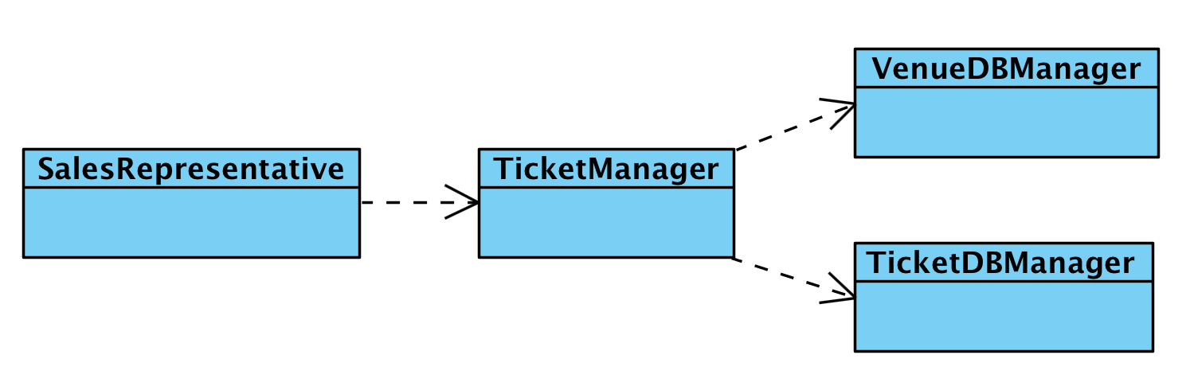
Example
The SalesRepresentative class depends on:
TicketManager – to place orders
The TicketManager class depends on:
VenueDBManager – to determine show dates/times
TicketDBManager – to determine ticket availability

Slide 20
Dependency keywords
Keywords can be used to describe dependencies
Keyword | Meaning
<<call>> | The source calls an operation in the target.
<<create>> | The source creates instances of the target.
<<derive>> | The source is derived from the target.
<<instantiate>> | The source is an instance of the target.
<<permit>> | The target allows the source to access the target’s private features.
<<realize>> | The source is an implementation of a specification or interface defined by the target.
<<refine>> | Refinement indicates a relationship between different semantic levels.
<<substitute>> | The source is substitutable for the target.
<<trace>> | Used to track such things as requirements to classes or how changes in one model link to changes elsewhere.
<<use>> | The source requires the target for its implementation.

Slide 21
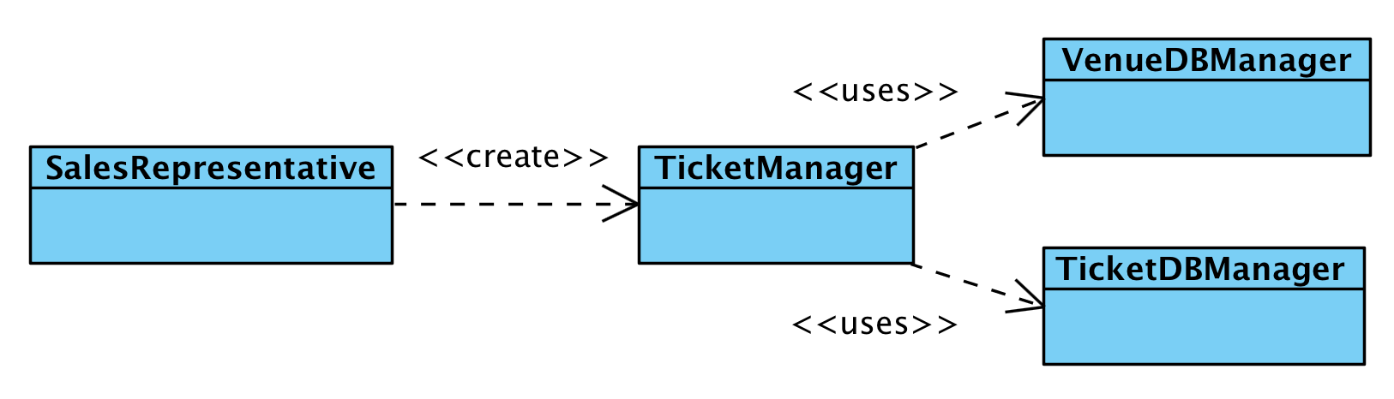

Example

Slide 22
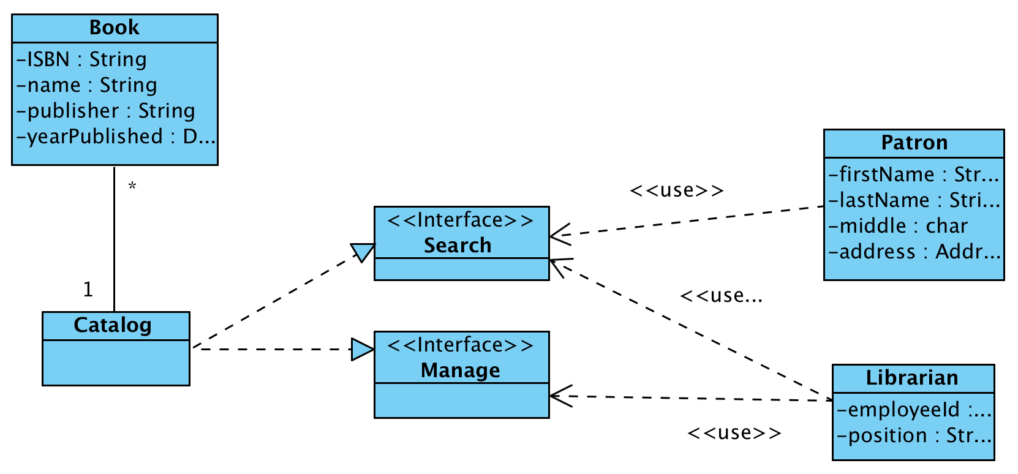
Another example

Slide 23
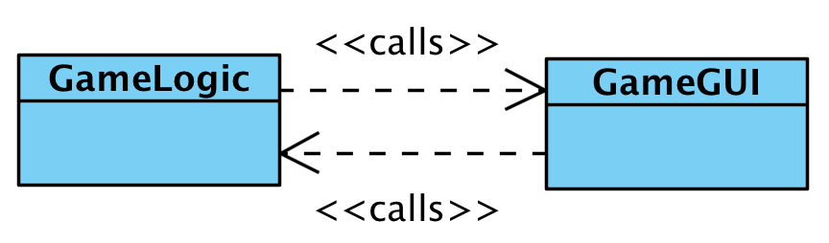
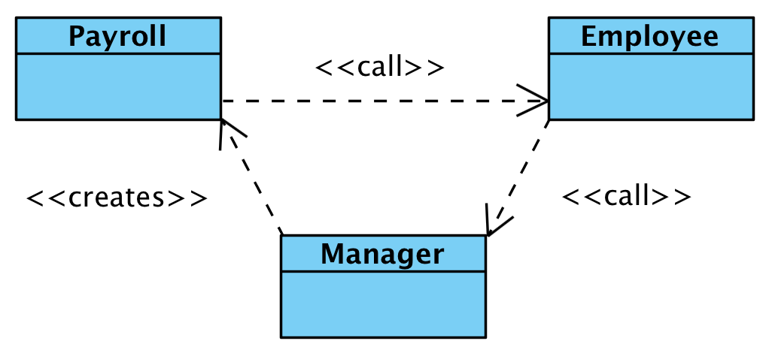
Avoid…
Two-way dependencies
Circular dependencies

Slide 24
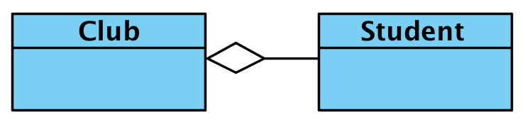
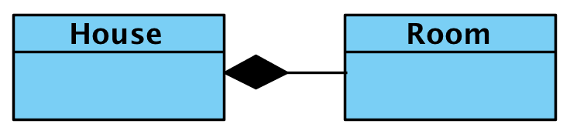
Aggregation and composition
Represent "part-of" relationships
Examples: Car – tires, Class – student, House – room
Aggregation: represents a non-dependent relationship
Composition: represents a dependent relationship

Slide 25
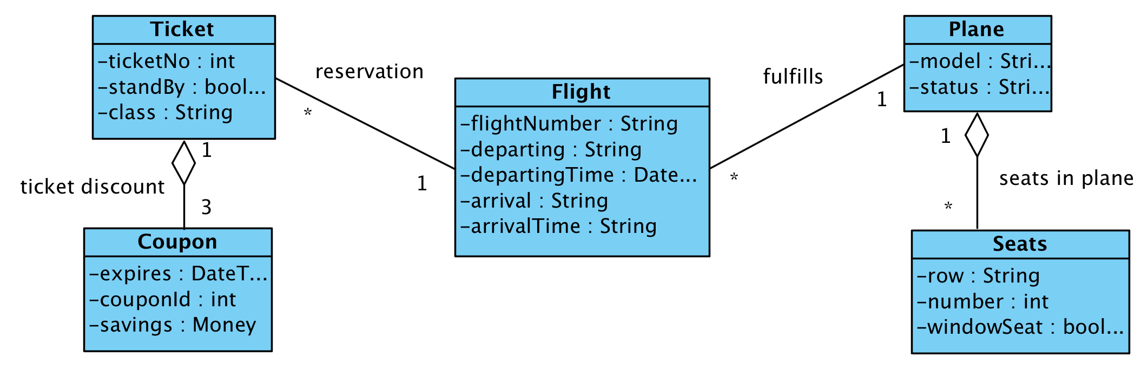
Aggregation example

Slide 26


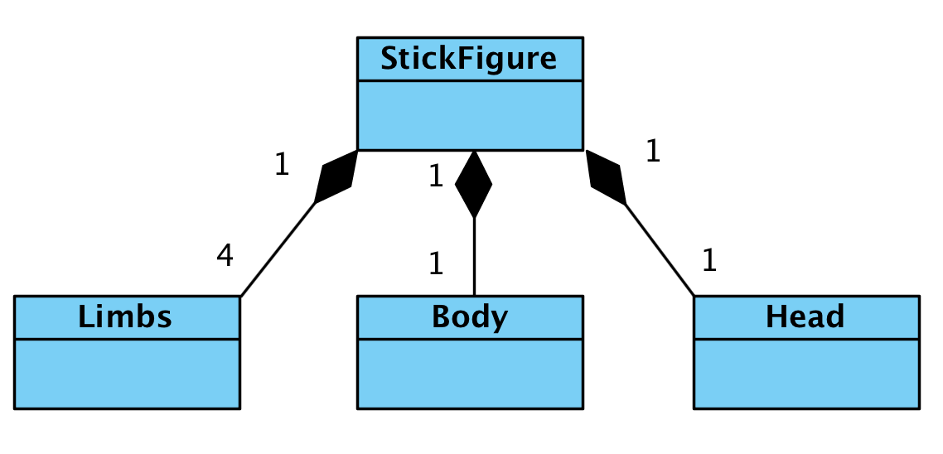
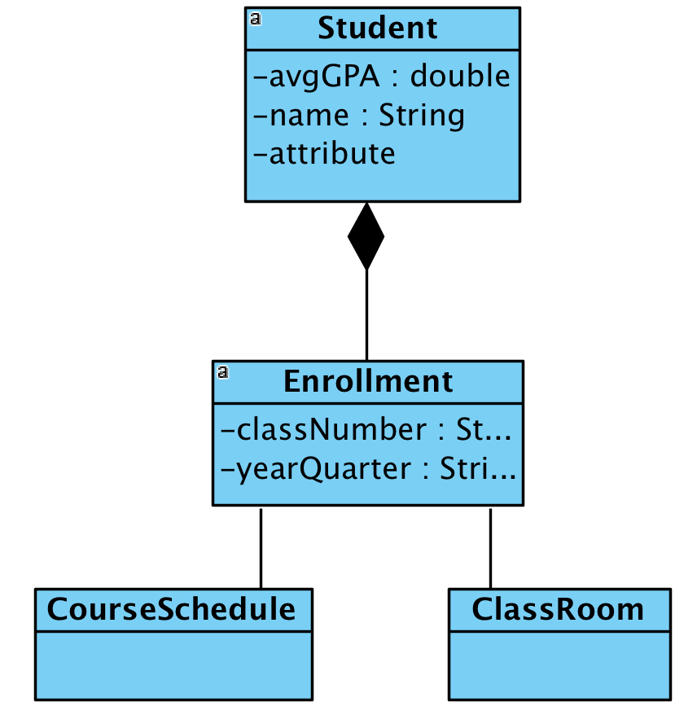

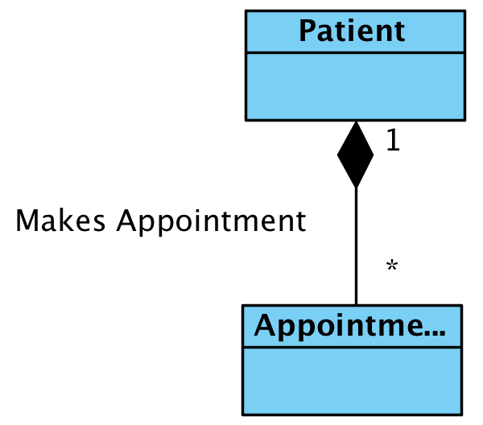
Composition examples

Slide 27
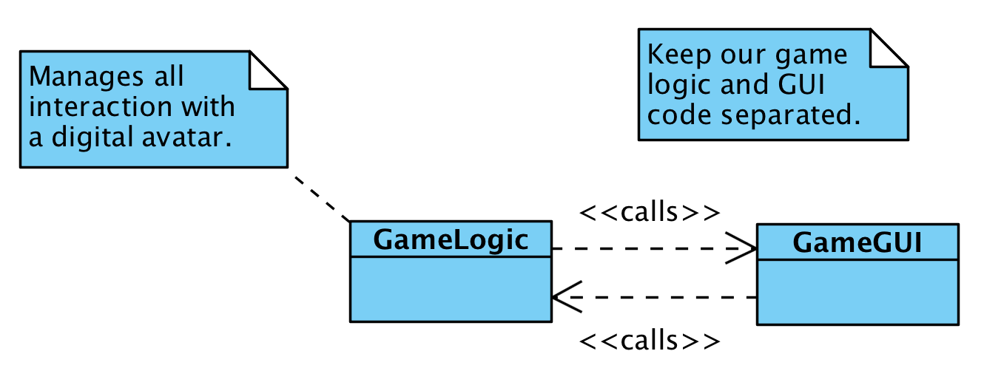
Notes
Notes can be added to any UML diagram
These can be associated with a class diagram or not

Slide 28
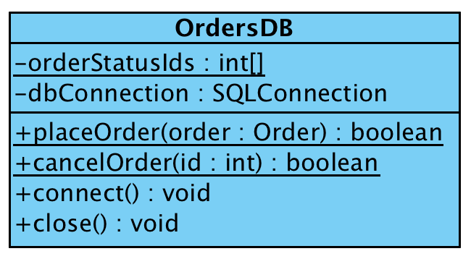
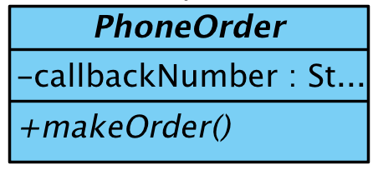

Other notations
Static content
Abstract classes
Static fields or methods are underlined
Abstract classes and methods are italicized

Slide 29
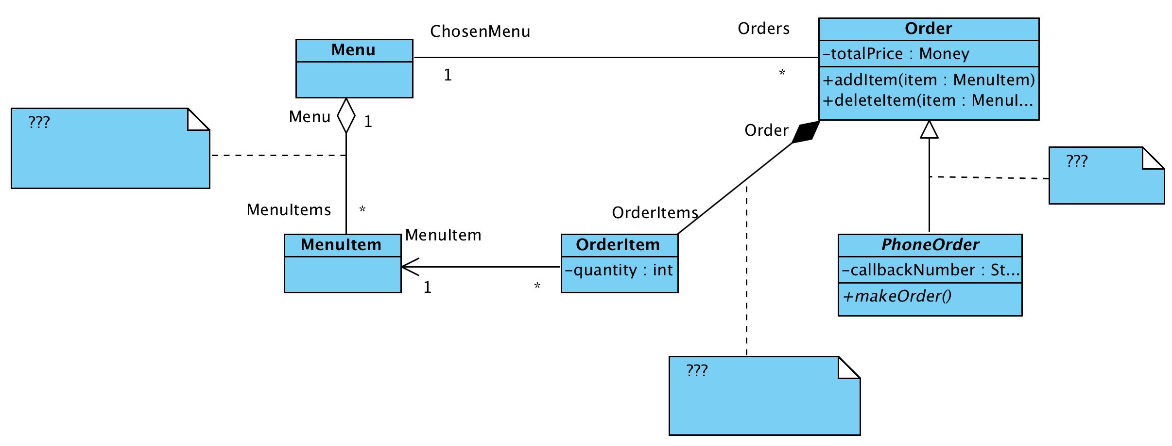
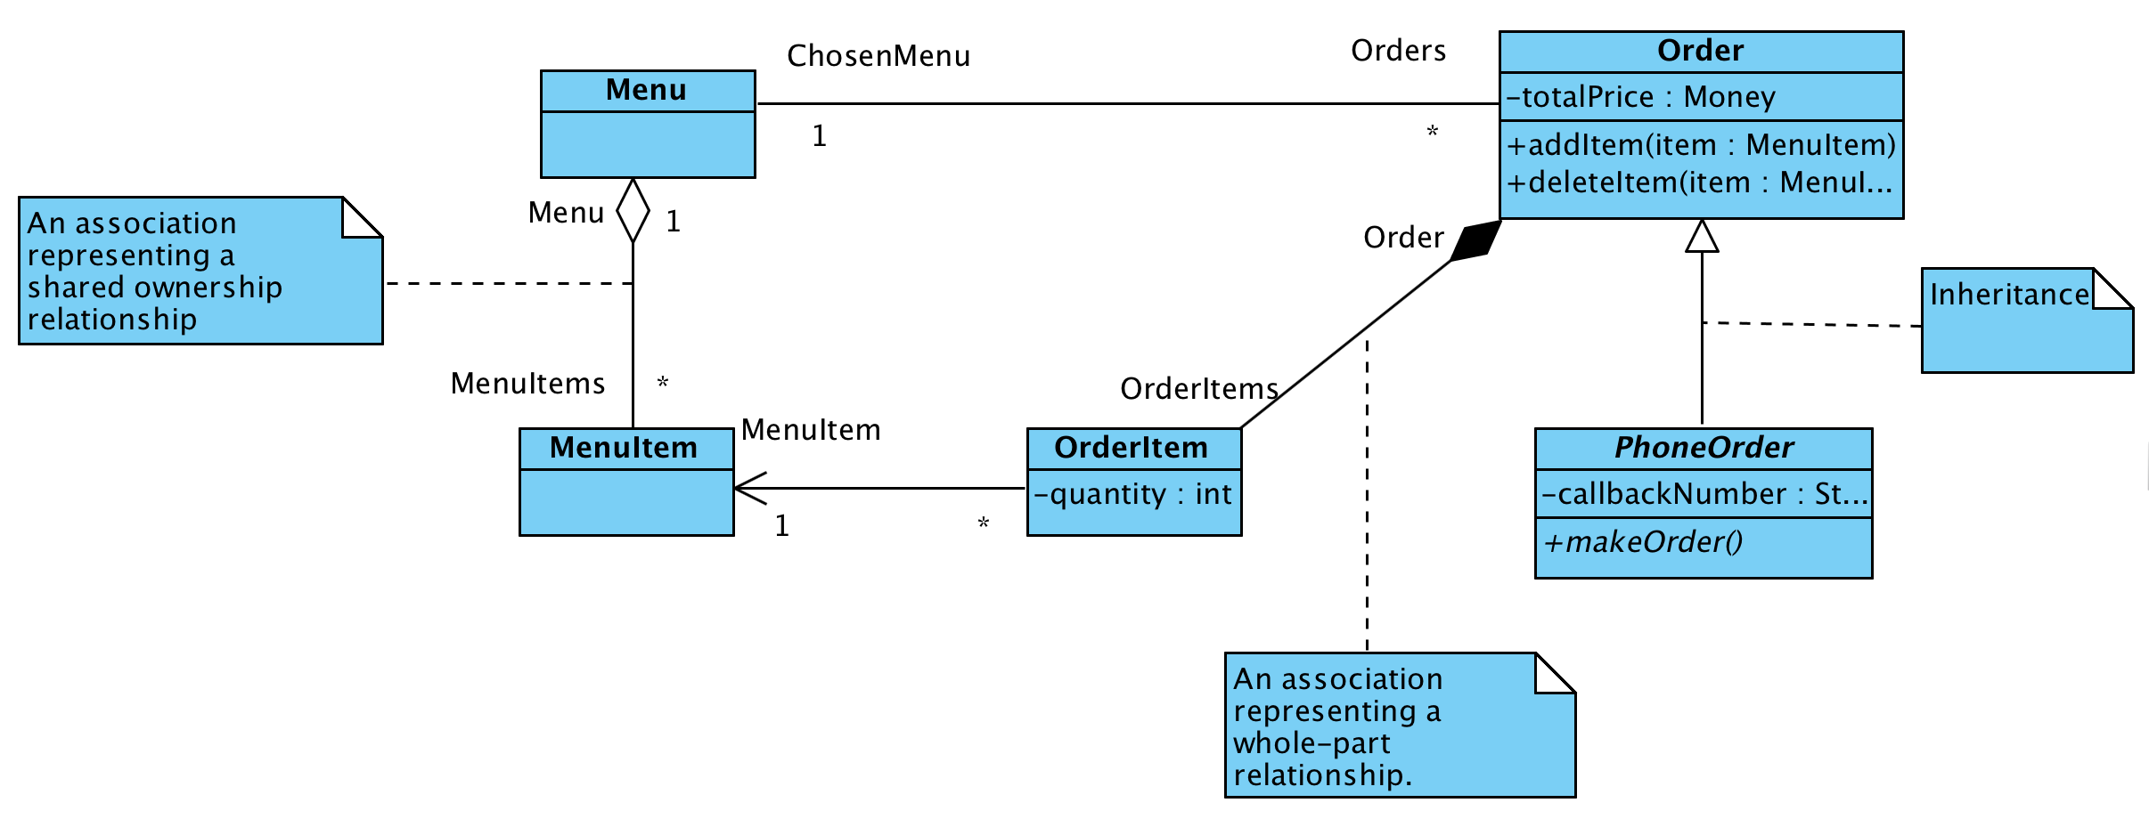
Reading class diagrams
What relationships are depicted in the following diagram?

Slide 30
Sources
Fowler, Martin. UML Distilled. New Jersey: Pearson Education, 2004.

Slide 31
UML
Class Diagrams
IT 426

